Slide 1
MLC’s
Instructor
Program
For the community, by the community.

Slide 2
What’s the MLC’S Instructor Program?
The MLC Instructor Program is an opportunity for member organizations, & the instructors who fill their programs, to share knowledge & provide opportunities for professional growth.
The MLC Board of Directors has voted to fund up to $10,000 to provide this valuable member experience.
Applications opens OCT 2023 & close DEC 4 2023.

Slide 3
What’s involved?
Who can participate?
What was that about the program being funded?

Slide 4
1. What’s involved?
Three ways to participate:
Shadow Travel to a host MLC organization & work alongside their team as they conduct programs & give you an inside look at the curriculum, methods, & ethos that drive their mobile mab.
Host Provide the opportunity to have an MLC member shadow your team; both in-field and in-office time is expected as well as any special areas of education & professional development that the host excels in.
Exchange Two member organizations exchange instructors for two shadow experiences occurring simultaneously or not.

Slide 5
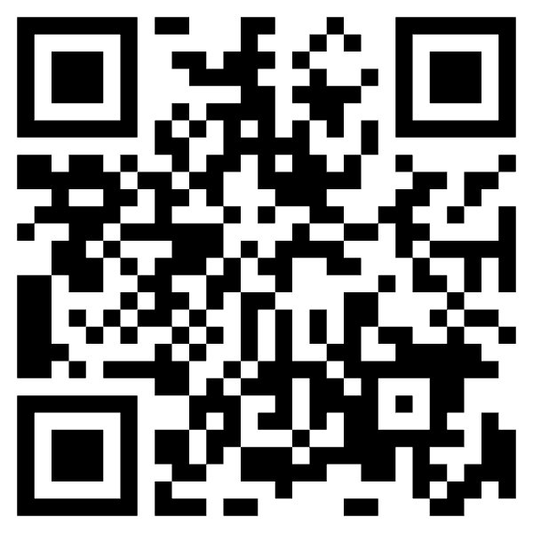
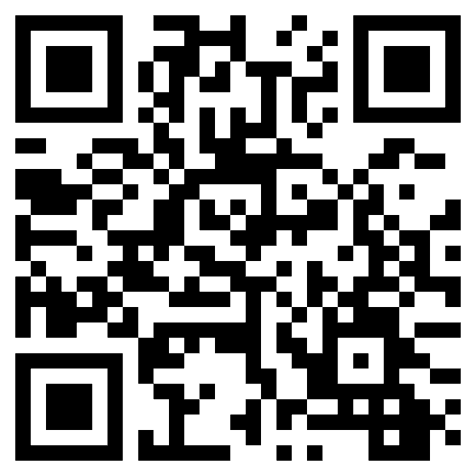
2. Who can participate?
Any *current MLC organization &/or member may submit an application to participate as a Shadow, Host, or Exchange. *Membership must be up-to-date at time of application.
Renew your membership here:
Join the Mobile Lab Coalition here:

Slide 6
3. It’s funded?!
Yes! The MLC Board of Directors voted to fund the Instructor Program & cover the cost of the following:
Instructors (Shadow & Exchange) -Roundtrip travel -Housing for 3 nights -Daily food per diems -Complimentary registration to MLC’s 2024 Conference
Hosts -Expenses & experience for guest -Complimentary registration to MLC’s 2024 Conference

Slide 7
Timeline
OCT 2023
Winter & Spring 2024
JUL 2024
DEC 4 2023
JAN 2024
Late Spring 2024
Application Opens
Participants travel to host sites.
IP Participants present @MLC Conference
2023 |  |  |  | 2024
Application Closes
IP Participants Announced
IP Participants reflect & prepare a capstone presentation for the MLC community

Slide 8
Wait! Application?
(Don’t worry. It’s a few questions & some creativity.)

Slide 9
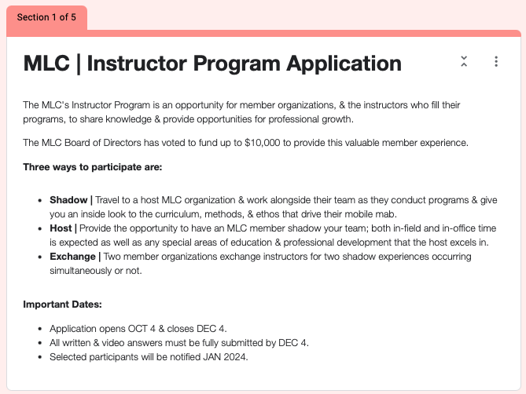
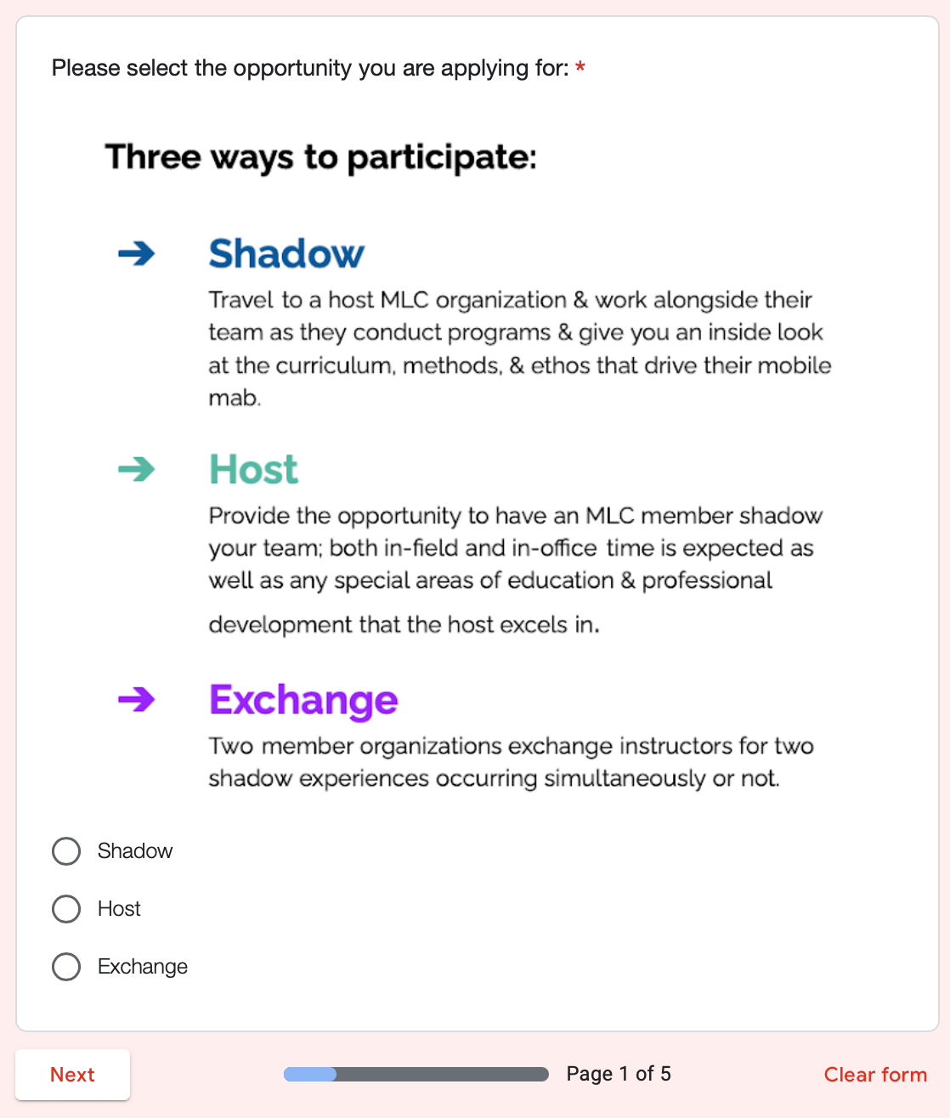
Application
Notes:
Link: https://forms.gle/VaxFXCw2eQqgdrKGA

Slide 10
4. Application?
The application for the MLC Instructor Program is not meant to cause you great labor: Pt. 1: Written | ~500 Words Shadow: *What do you want to glean from an MLC host Organization? *What do you hope to gain from this experience?
Host: *What's a sample 3-day agenda a Shadow participant might experience during their visit to your site? *What unique learning do you hope to provide a Shadow participant?
Exchange: *What's a sample 3-day agenda an Exchange participant might take-on during their visit to your site? *How do you hope to gain & grow by taking on duties at a fellow MLC organization?
Notes:
Link: https://forms.gle/VaxFXCw2eQqgdrKGA

Slide 11
4. Application?
Opens: OCT 2024 Closes DEC 4 2024 Selected participants announced: JAN 2023 Pt 2: ~60 Second Video Shadow: *What do you hope to glean & how do you hope to grow by traveling to & joining a sister MLC organization for 3 days? Host: *What unique expertise/experiences/education would a Shadow Instructor gain by joining your organization for 3 days? *What should a Shadow Instructor be ready to see & do with your organization during their visit? Exchange: *What do you hope to glean & how do you hope to grow by traveling to & joining a sister MLC organization for 3 days? *What unique learning experience do you hope to provide for the visiting exchange instructor?
Notes:
Link: https://forms.gle/VaxFXCw2eQqgdrKGA

Slide 12
Agreements & Action Items
Each participant & host will provide written approval from supervisor/organization of participation in MLC’s IP experience.
Each participant & host will produce social media content (text, photo, & video) during the IP experience.
Each participant & host must conduct the IP experience by JUL 1 2024 & have submitted all receipts.
Each participant & host agrees to attend MLC Conference in Charleston, SC July 15-18 2024.
Each participant & host agrees to present a capstone presentation at MLC Conference in Charleston, SC July 15-18 2024.

Slide 13
Sample Week of MLC’s Instructor Program
Travel Day
Day 2 @Host
Day 1 @Host
Day 3 @Host & Travel Day
Leave home city & arrive in host city.
Growing & gleaning continued…
Monday | Tuesday | Wednesday | Thursday | Friday
Experiences will vary but a combination of in-office & in-field time is expected.
Visit completed & participants return home after 3 nights away.

Slide 14
How will participants be selected?
Scenario 1
2 Shadows + 2 Hosts
2 Exchanges + 2 Hosts
Scenario 2
4 Shadows + 4 Hosts
Scenario 3
4 Exchanges + 4 Hosts
Depending upon applications received there could be a variety of scenarios & selected participants:
MLC Board will meet DEC 12 to determine qualified participants utilizing a scoring rubric.

Slide 15
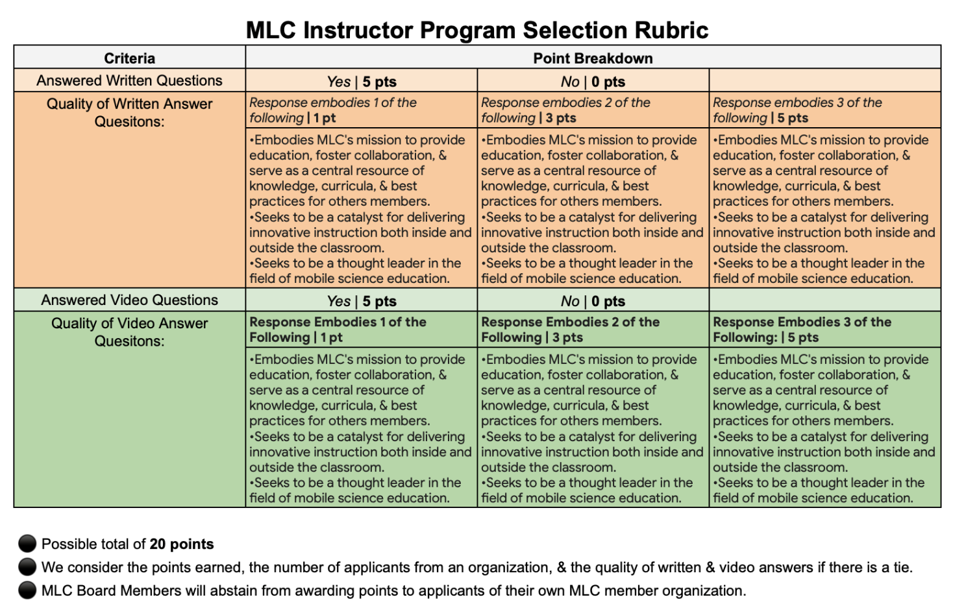
Rubric
Notes:
Link to edit: https://docs.google.com/spreadsheets/d/1I4z3vKtUBco-_ZfeAp8zOaIB1LJHwsTX98DIraR9rck/edit?usp=sharing

Slide 16
MLC’s
Instructor
Program
For the community, by the community.

